Slide 1


GENERATING INSIGHTS FROM PRODUCT REVIEWS
Using NLP to Turn Customer Reviews into Actionable Business Intelligence
Alpha Anindita | University of Bristol
Supervisor- Prof. Ben Hicks

Slide 2
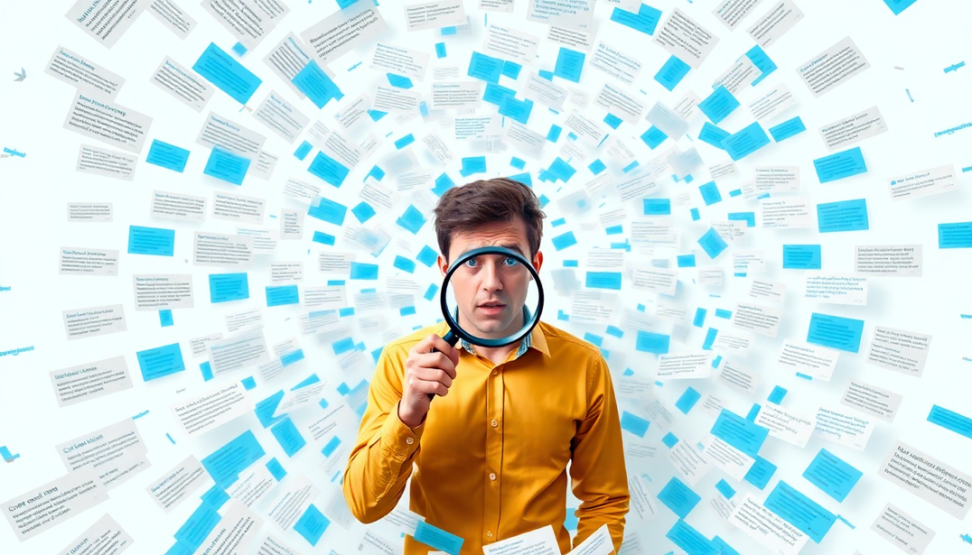
1
THE PROBLEM: AN UNTAPPED GOLDMINE
Millions of product reviews are posted online every day. This is a vast repository of customer feedback containing invaluable insights about product performance, user satisfaction, and market trends.
However, the sheer scale and unstructured nature of this text make it a fundamental challenge for businesses to systematically extract actionable intelligence to inform strategic decisions.
University of Bristol | 2025

Slide 3

2
PROJECT AIM: FROM RAW
REVIEWS TO SMART DECISIONS
My aim was to investigate how state-of-the-art Natural Language Processing (NLP) can generate actionable insights from reviews and to propose enhanced data collection strategies for better business intelligence.
Why is this important?
For Businesses: Make smarter decisions on product improvements, marketing, and strategy.
For Consumers: Get better products and make more informed purchasing choices.
For Research: Create powerful and accessible analysis tools by combining traditional NLP and modern AI.
University of Bristol | 2025

Slide 4
3
KEY INNOVATION: THE BEST OF BOTH WORLDS
Traditional NLP
The core of my approach is a hybrid model that integrates fast, traditional methods with the deep contextual understanding of modern AI, all deployed locally for privacy and efficiency.
Fast & efficient for large datasets.
Good for high-level sentiment (Positive, Negative).
Transparent and interpretable.
University of Bristol | 2025
Modern AI (Local LLM)
Understands nuance and context.
Summarizes complex feedback.
Uncovers the 'why' behind the rating

Slide 5
4
MY APPROACH: A MULTI-LAYERED ANALYTICAL WORKFLOW
I created an integrated pipeline to analyze reviews from multiple angles. This avoids relying on a single method and provides a more robust, holistic understanding of customer feedback.
Data Loading and Initial Exploration
Text Preprocessing
LLM Based Prompt Engineering
N- gram Analysis
Sentiment Analysis
Contextual Text Mining
Aspect based Sentiment Analysis
Word Cloud
University of Bristol | 2025

Slide 6



5
TESTING THE FRAMEWORK: THREE DIVERSE CASE STUDIES
The Success Story
The Cautionary Tale
The Mixed Bag
Wireless headphones whose rating plummeted from 5.0 to 1.7 stars due to quality issues.
A variety of energy products (smart meters, circuit breakers) with diverse feedback.
An under-cabinet range hood with a stable 4.6-star rating over 14 years.
University of Bristol | 2025

Slide 7
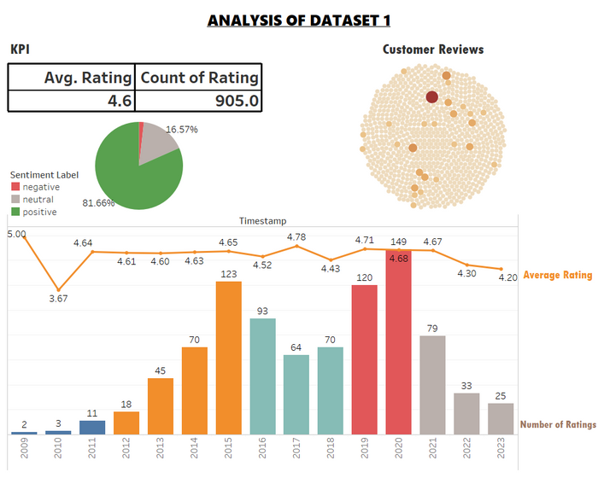
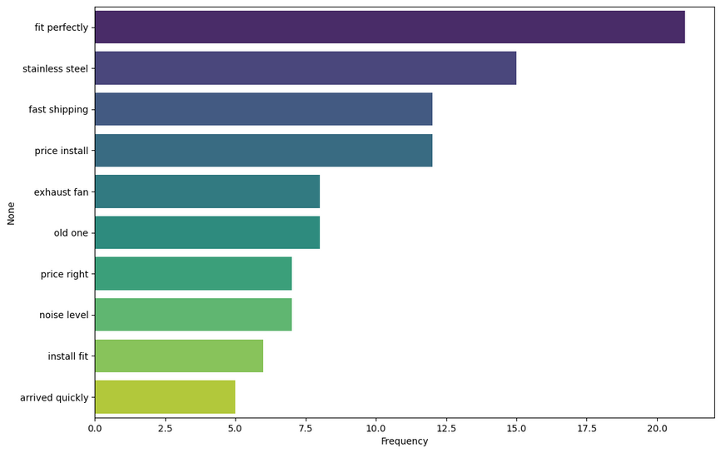
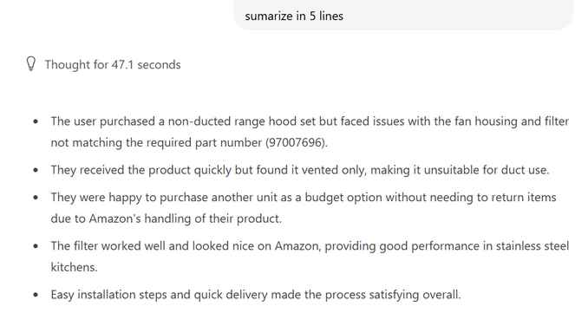
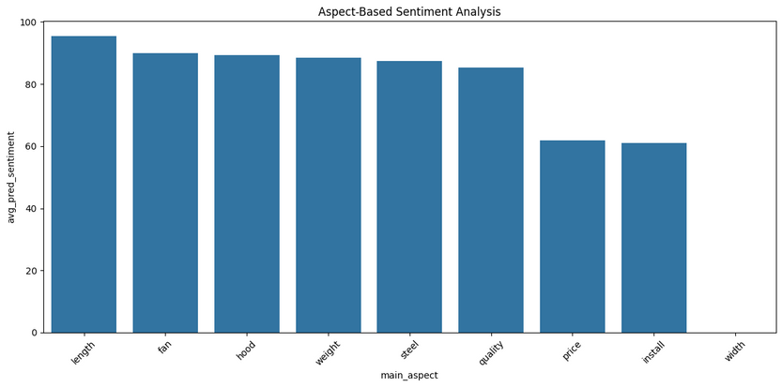
6
FINDING 1: THE APPLIANCE SUCCESS STORY
KPIs with overall Sentiment Distribution, Temporal Analysis and most frequent review.
N-Gram Analysis for positive reviews after filtering domain specific words and post lemmatization.
University of Bristol | 2025
Aspect Based Sentiment Analysis with custom dictionary.
LLM summarization of reviews with most helpful votes.

Slide 8
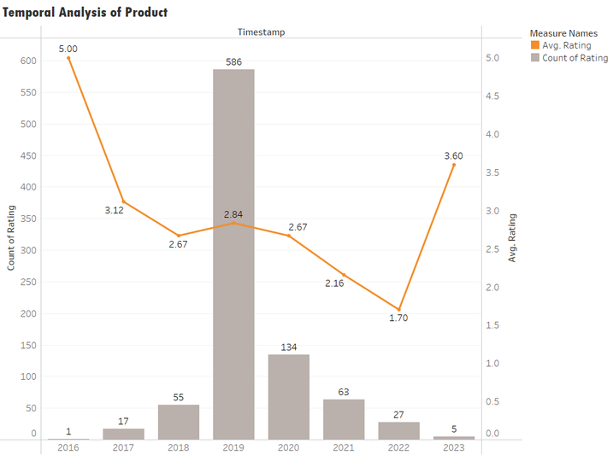
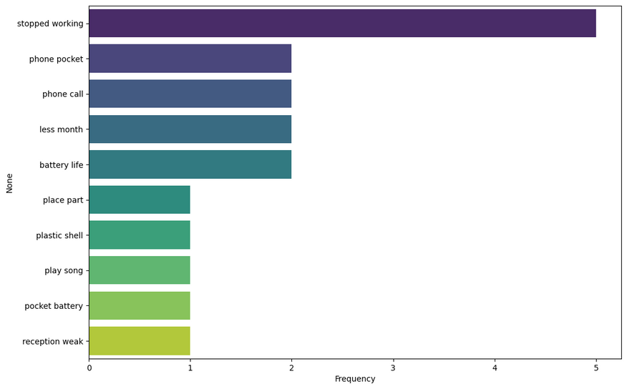
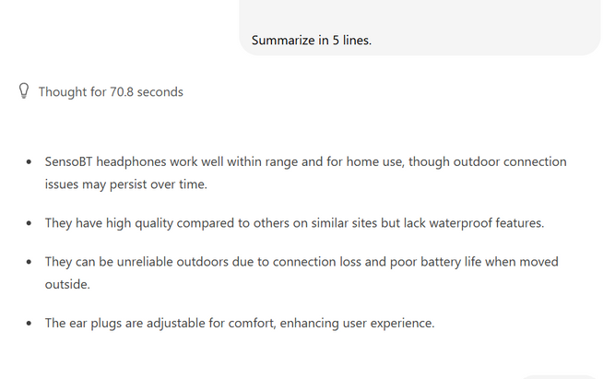
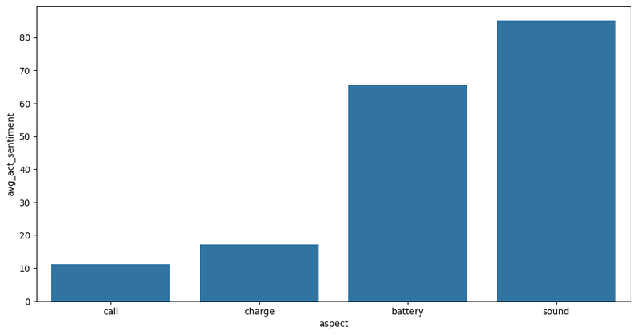
7
FINDING 2: THE WIRELESS HEADPHONE FAILURE
Temporal Analysis
N-Gram Analysis for negative reviews after filtering domain specific words and post lemmatization.
University of Bristol | 2025
Aspect Based Sentiment Analysis with custom dictionary.
LLM summarization of reviews with most helpful votes.

Slide 9
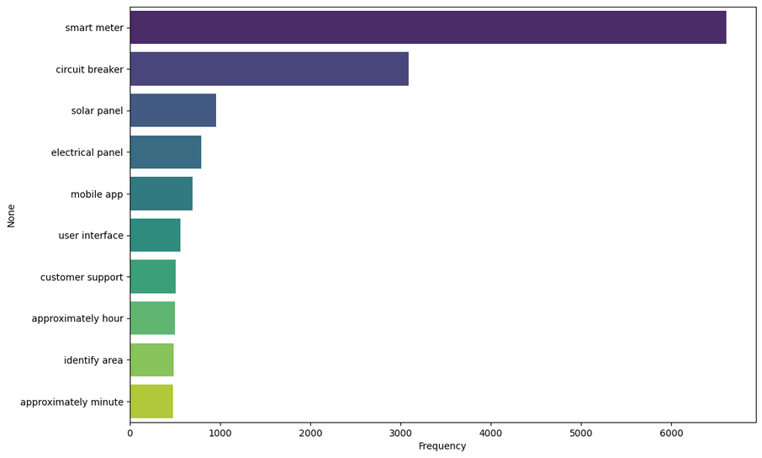
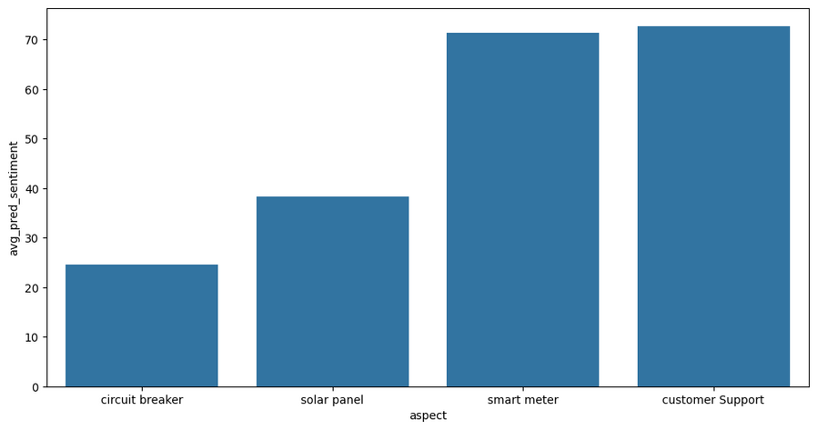
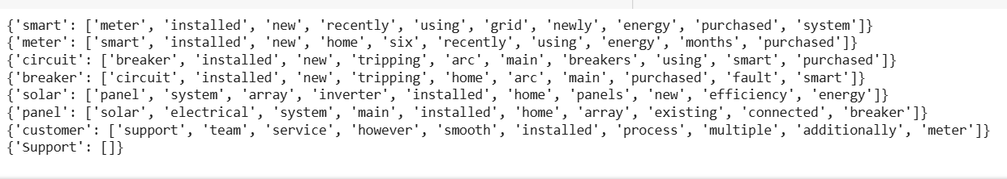
8
FINDING 3: THE MIXED PRODUCT
University of Bristol | 2025
N-Gram Analysis
Sentiment Analysis
Contextual Word Mining

Slide 10

9
THE LIMITS OF JUST ANALYSING REVIEWS
Lack of Technical Detail: Reviews say "poor battery life," not "poor battery life = 2hours." This isn't specific enough for engineers.
Contextual Ambiguity: Expressions like "good for the price" are subjective and hard to quantify.
Passive Feedback: We only learn about existing features. We can't use this data to test new ideas or uncover unmet needs.
University of Bristol | 2025

Slide 11

10
CONCLUSION
What I Achieved
Built a robust, reusable NLP framework to analyse product reviews from multiple angles.
Demonstrated how combining traditional and modern AI yields richer, more reliable insights.
Showed a clear link between review sentiment patterns and product lifecycle outcomes.
The Path Forward
The key takeaway is that future competitive advantage will come from designing intelligent review tracking systems, not just from more cleverly analyzing the data we already have.
University of Bristol | 2025

Slide 12

11
RECOMMENDATION
From Passive Listening to Active Asking
The Old Way
Customer writes: "The battery life is okay." This is ambiguous and not very actionable.
A Hybrid Solution
After the text review, ask targeted questions: -
Battery life ? - bad, average, good
How long does the battery last? - (<2h, 2-4h, >4h)
This combines the 'what' (quantitative data) with the 'why' (qualitative text), adding review with specific feature
University of Bristol | 2025

Slide 13
University of Bristol| 2025
THANK YOU
Presented By : Alpha Anindita

